Slide 1
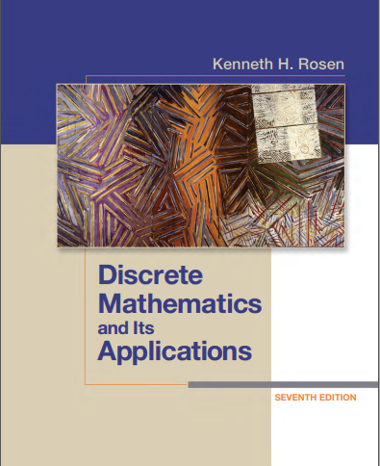

Discrete structures
By Dr. sajid iqbal
Course Reference Book

Slide 2
Introduction to proofs
Chapter - 1

Slide 3
Background
Axiom: A statement that is taken to be true, so that further reasoning can be done.
It is not something we want to prove. The statements used in a proof are called axioms
Proposition: A declarative sentence that is either True or False, but not both.
A less important theorem is also called the proposition
Hypothesis: A hypothesis (plural hypotheses) is a proposed explanation for a phenomenon
Theorem: A general proposition not self-evident but proved by a chain of reasoning
A truth established by means of accepted truths
Notion: The concept of a proof
Methods: For constructing proofs

Slide 4
Background
Proof: A proof can use the hypotheses of the theorem, if any, axioms assumed to be true, and previously proven
Lemma: A less important theorem that is helpful in the proof of other results
Series of lemmas are used to prove the complicated proofs
Each lemma is proved individually
Corollary: A corollary is a theorem that can be established directly from a theorem that has been proved
Conjecture: A conjecture is a statement that is being proposed to be a true statement, usually on the basis of some partial evidence, a heuristic argument, or the intuition of an expert.
When a proof of a conjecture is found, the conjecture becomes a theorem
Many times conjectures are shown to be false, so they are not theorems

Slide 5
Background
Proof Ingredients
Axiom
Proposition
Hypothesis
Theorem
Rules of Inferences
Using above listed ingredients, establish the truth of the statement to be proved

Slide 6
Types of proofs
Formal Proofs
Good for computers in automatic reasoning
Statements involving propositions and quantified statements are true where
All steps are supplied, and
The rules for each step in the argument are given
Informal Proofs
Informal proofs can often explain to humans why theorems are true
The proofs of theorems designed for human consumption are almost always informal proofs where
more than one rule of inference may be used in each step
steps may be skipped
the axioms being assumed and
The rules of inference used are not explicitly stated

Slide 7
Importance of methods of proofs
These methods are used to prove mathematical theorems
Methods of proofs have applications in computer science
Software process verification
Software security verification i.e. operating systems
making inferences in artificial intelligence
showing that system specifications are consistent
…

Slide 8
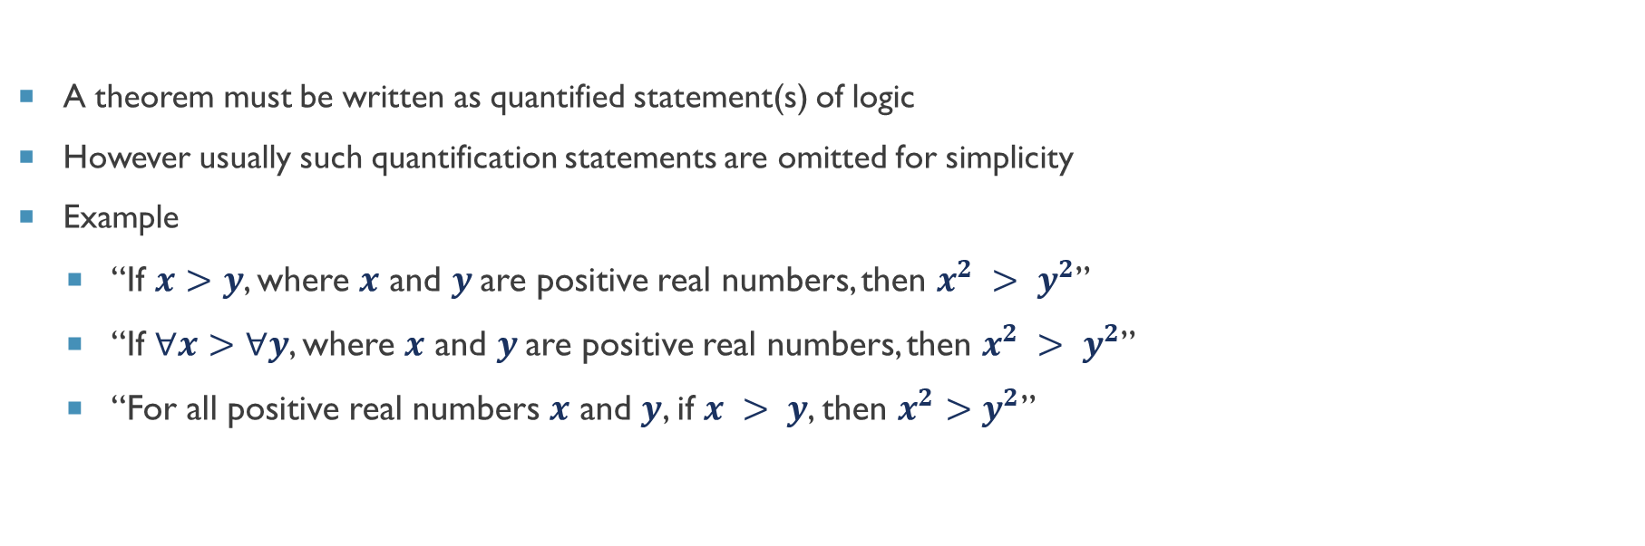
How to state a theorem
A theorem must be written as quantified statement(s) of logic
However usually such quantification statements are omitted for simplicity
Example
“If $x>y$, where $x$ and $y$are positive real numbers, then $x^{2} > y^{2}$”
“If $∀x>∀y$, where $x$ and $y$are positive real numbers, then $x^{2} > y^{2}$”
“For all positive real numbers $x$ and $y$, if $x > y$, then $x^{2}>y^{2}$”

Slide 9



Thanks for watching
Dr. Sajid Iqbal
Assistant Professor
Department of Computer Science
Bahauddin Zakariya University, Multan
sajidiqbal.pk@gmail.com
https://github.com/sajjo79/DiscreteMathematics
Allah Hafiz
COMEDXD

